Slide 1
Milestone 3 – Conceptual Model
Notes:
Hi there, my name is DB and I have got the honor of introducing SIMTECH to you. *click*

Slide 2
Agenda
Modeling
Assumptions
Petri Net
Administration
Budget
Progress
Outlook
Lessons Learned
Next Steps
Milestone 3 – Conceptual Model
Notes:
So, who is SIMTECH? After much deliberation, we came up with the following distribution of roles, :
*fingerpointing* Sharath, main Conceptual modeler; Aleksei Baidarov, Pham Huu
Aleksei Baidarov,

Slide 3
Conceptual Model
Concetual Modelling is the process of abstracting a model from a real or prposed system after a conceptualization process in mind.
Model make us to gain insight in the system, to get ideas to improve the design and to locate the design errors and other shortcomings.
Model helps to ensure completness and improve the correctness of the design.
Milestone 3 – Conceptual Model
Notes:
So, who is SIMTECH? After much deliberation, we came up with the following distribution of roles, :
*fingerpointing* Sharath, main Conceptual modeler; Aleksei Baidarov, Pham Huu
Aleksei Baidarov,

Slide 4

Assumptions
StVO Rules
…Speeding
…No accidents
…Infinite patience
Cars & Trams
…Traffic lights
…No trucks, busses, bicycles
…No pedestrians
Space & Time
…Excluding ‘Breiter Weg‘
…no seasonal influences
Milestone 3 – Conceptual Model
Notes:
Simply put: We want to create value for the customer – if we were real consultants, that would be the second highest priority.
First would be getting paid. But as we dont get paid, we still might learn something – getting better at working with strangers for instance, and creating our own frameworks to perform in. From scratch.
This is a sandbox, but an even better one than an internship (which you would do alone) And get grades.
This is what we want to achieve in theory. *click*

Slide 5
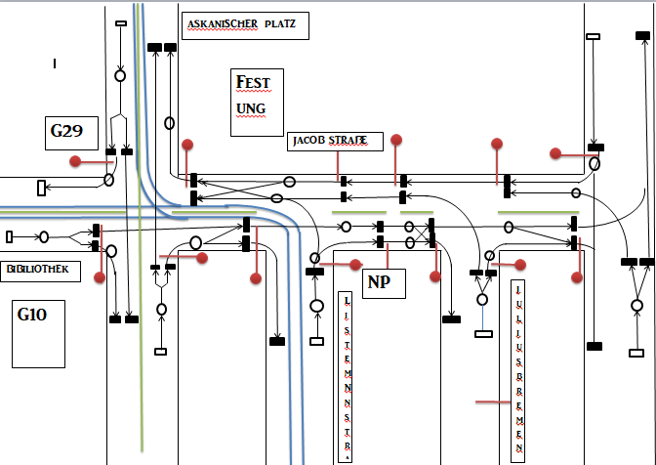
PetriNet
Milestone 3 – Conceptual Model
Notes:
Simply put: We want to create value for the customer – if we were real consultants, that would be the second highest priority.
First would be getting paid. But as we dont get paid, we still might learn something – getting better at working with strangers for instance, and creating our own frameworks to perform in. From scratch.
This is a sandbox, but an even better one than an internship (which you would do alone) And get grades.
This is what we want to achieve in theory. *click*

Slide 6
PetriNet
Pedestrians and cyclists are given less priority because they are always controlled by traffic signals
For decision making
Current State
Event Start
Milestone 3 – Conceptual Model
Notes:
Simply put: We want to create value for the customer – if we were real consultants, that would be the second highest priority.
First would be getting paid. But as we dont get paid, we still might learn something – getting better at working with strangers for instance, and creating our own frameworks to perform in. From scratch.
This is a sandbox, but an even better one than an internship (which you would do alone) And get grades.
This is what we want to achieve in theory. *click*

Slide 7
Quantities
Traffic signal timings
Tram Timings
Approx. Number of cars in each direction
Pedestrian crossing time
Length of the tram track
Milestone 3 – Conceptual Model
Notes:
Simply put: We want to create value for the customer – if we were real consultants, that would be the second highest priority.
First would be getting paid. But as we dont get paid, we still might learn something – getting better at working with strangers for instance, and creating our own frameworks to perform in. From scratch.
This is a sandbox, but an even better one than an internship (which you would do alone) And get grades.
This is what we want to achieve in theory. *click*

Slide 8
Experiments
Number of Tram stations-2
Direction of Tram
1. Through Askanicher Platz.
2. Through Universität Bibiliothek
3. Through Listemannstraße
Frequency of Tram
Tram station Location
Milestone 3 – Conceptual Model
Notes:
Simply put: We want to create value for the customer – if we were real consultants, that would be the second highest priority.
First would be getting paid. But as we dont get paid, we still might learn something – getting better at working with strangers for instance, and creating our own frameworks to perform in. From scratch.
This is a sandbox, but an even better one than an internship (which you would do alone) And get grades.
This is what we want to achieve in theory. *click*

Slide 9
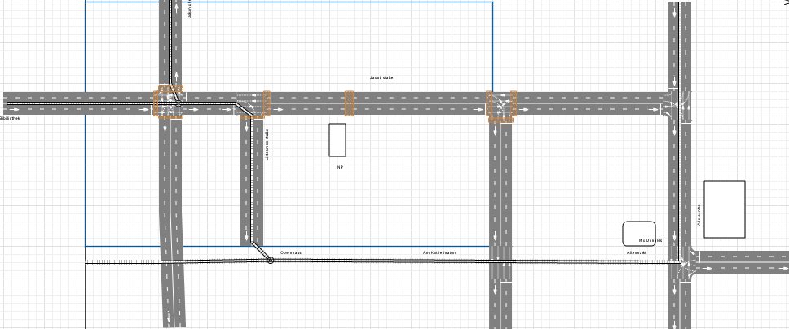
Experiments
Milestone 3 – Conceptual Model
Notes:
Simply put: We want to create value for the customer – if we were real consultants, that would be the second highest priority.
First would be getting paid. But as we dont get paid, we still might learn something – getting better at working with strangers for instance, and creating our own frameworks to perform in. From scratch.
This is a sandbox, but an even better one than an internship (which you would do alone) And get grades.
This is what we want to achieve in theory. *click*

Slide 10
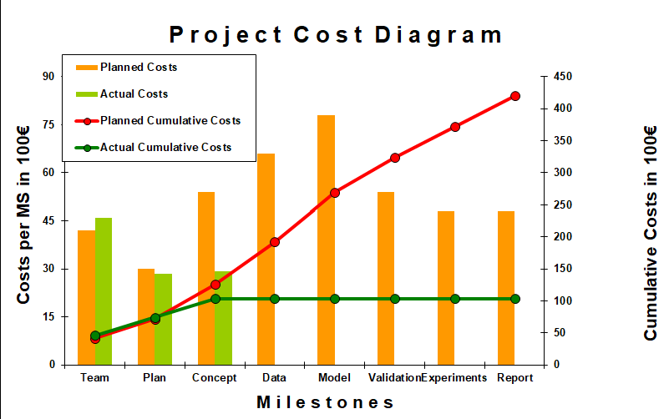
Budget
Milestone 3 – Conceptual Model
Notes:
Simply put: We want to create value for the customer – if we were real consultants, that would be the second highest priority.
First would be getting paid. But as we dont get paid, we still might learn something – getting better at working with strangers for instance, and creating our own frameworks to perform in. From scratch.
This is a sandbox, but an even better one than an internship (which you would do alone) And get grades.
This is what we want to achieve in theory. *click*

Slide 11
Lessons Learned
Problem: Meetings still unstructured
Solution: Agenda with Timeboxes
Problem: Learning from other teams after milestone
Solution: Rework passed milestone asap
Problem: Excel + Dropbox not ideal
Possible Solutions:
Sharepoint
GoogleDocs
Milestone 3 – Conceptual Model
Notes:
So, who is SIMTECH? After much deliberation, we came up with the following distribution of roles, :
*fingerpointing* Sharath, main Conceptual modeler; Aleksei Baidarov, Pham Huu
Aleksei Baidarov,

Slide 12

THANK YOU...!
Milestone 3 – Conceptual Model
Notes:
So, who is SIMTECH? After much deliberation, we came up with the following distribution of roles, :
*fingerpointing* Sharath, main Conceptual modeler; Aleksei Baidarov, Pham Huu
Aleksei Baidarov,

